Slide 1
What are and How to Use Dynamics 365 Finance and Operations Microservices

Slide 2

Nathan Clouse
Technical Architect enVista Corp.
Microsoft Business Applications MVP (3x)
nclouse@envistacorp.com
www.atomicax.com
www.dynamics.fo
@NathanClouseAX
Nathan Clouse
Technical Architect, Microsoft MVP
enVista Corp.

Slide 3

Gift Card Giveaway
….. At the end

Slide 4
What is a Microservice?
How do they work?
Benefits and Drawbacks
What options are available?

Slide 5
What is a Micro Service
Microservices - also known as the microservice architecture - is an architectural style that structures an application as a collection of services that are “loosely coupled”
Highly maintainable and testable
Loosely coupled
Independently deployable
Organized around business capabilities
Owned by a small team

Slide 6
How do they work?
Process request(s) centered around 1 central topic (ie; Inventory On Hand)
Autonomous in relation to F&O
Specialized around 1 central topic (ie; view, edit on hand inventory)
Multiple microservices are grouped together to service an application or sub-system for a large application
Microservices can use other microservices

Slide 7
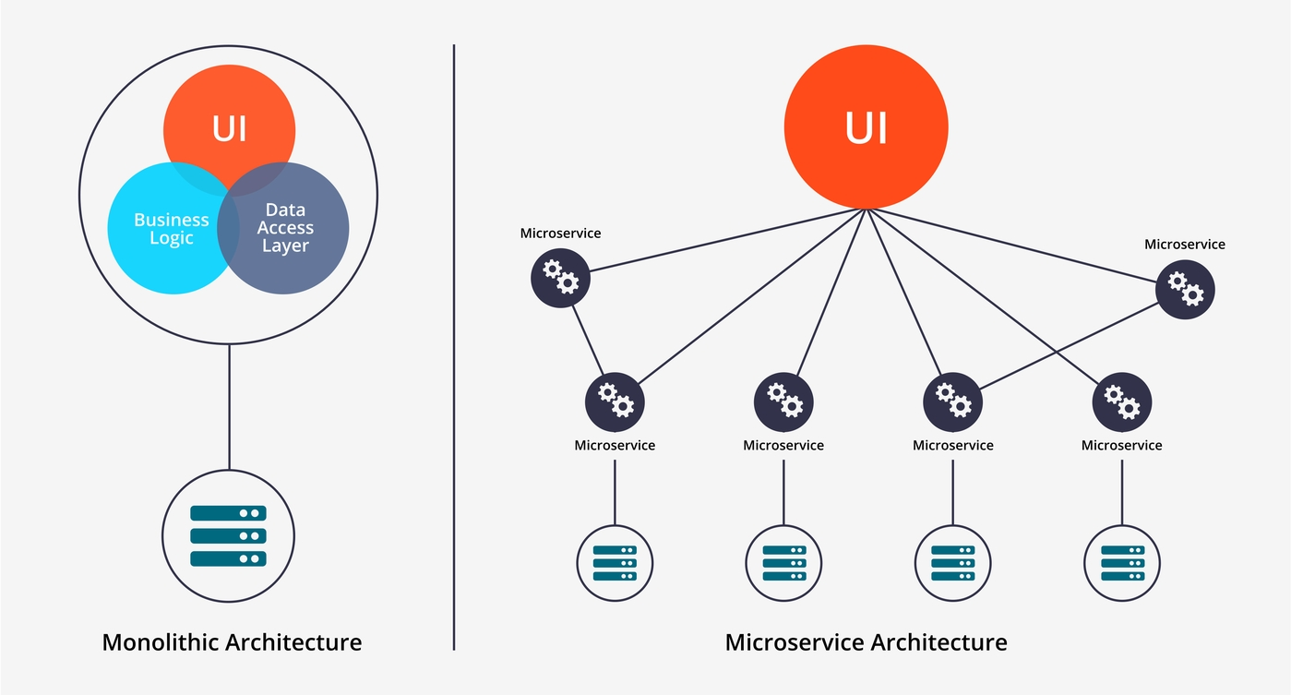

Slide 10
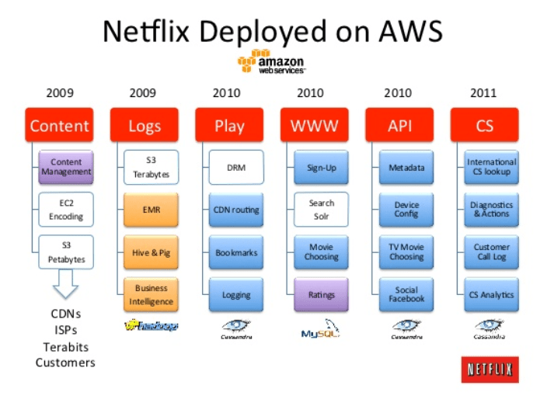

Slide 11
But Why?
The Good
The Bad
New functionality “bolted on”
Performance
New “experiences”
Unknowns
Troubleshooting
Limited Customization
Scale / Performance
Support

Slide 12
What Services are Available?
Power Platform Integration
Export to Data Lake
Planning Optimization
Tax Calculation Service
Finance Insights
Expense Management
Electronic Invoicing
Inventory Visibility
IoT Intelligence Sensor Data Intelligence
(Preview) Inventory Global Accounting

Slide 13
Power Platform Integration
Connects Finance and Operations to the Power Platform
Enables lots of new, extended, enhances functionality
Also opens new possibilities with tech from the Platform like…
Power Automate – for extended workflow options
Power Apps – new “experiences” with your data and workflows
Dataverse – expose data in new and different ways
Enabled LCS Add-Ins like Microservices
Dual-Write

Slide 14
Export To Data lake
Replacement for BYOD and Azure SQL reporting
Will replace Entity Store (AxDW)
Can replicate all tables, data entities and entirety of the entity store to data lake
Use Synapse to surface data in views that can be used just like anything else this is SQL
Notes:
https://www.powerazure365.com/blog-1/bi-architecture-hero-for-dynamics-365-with-azure-synapse

Slide 15
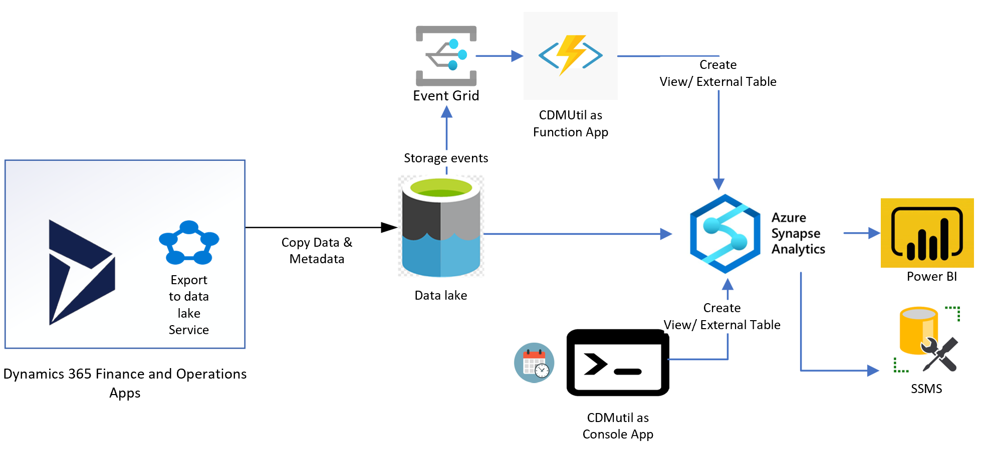
Export To Data lake
Notes:
https://www.powerazure365.com/blog-1/bi-architecture-hero-for-dynamics-365-with-azure-synapse

Slide 16
Export To Data lake
You can select up to 350 tables. All changes to data are continuously updated in the data lake. These changes include insert, update, and delete operations.
You can select data by using tables or entities. If you use entities, underlying tables are selected by the service.
You can select both standard and custom entities and tables.
You can work with data in the data lake by using Microsoft Azure Synapse Analytics or many other third party tools.
Tech Talk: https://www.youtube.com/watch?v=TNL2GO8LXj0
Notes:
https://www.powerazure365.com/blog-1/bi-architecture-hero-for-dynamics-365-with-azure-synapse

Slide 17
Planning Optimization
Improve planning performance through a shorter runtime.
Reduce the impact on other processes during the master planning run.
Do more frequent planning runs. (You aren't limited to daily runs.)
Be confident that future business growth won't overload the planning system.
Review Applicability: https://learn.microsoft.com/en-us/dynamics365/supply-chain/master-planning/planning-optimization/planning-optimization-fit-analysis

Slide 18
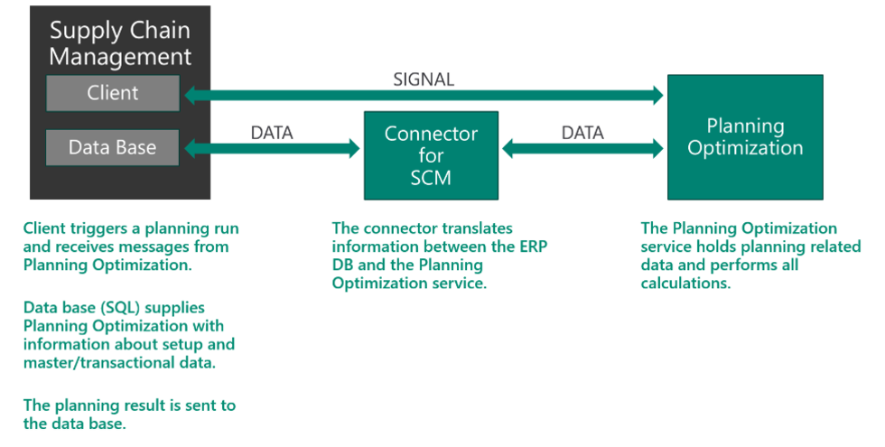
Planning Optimization

Slide 19
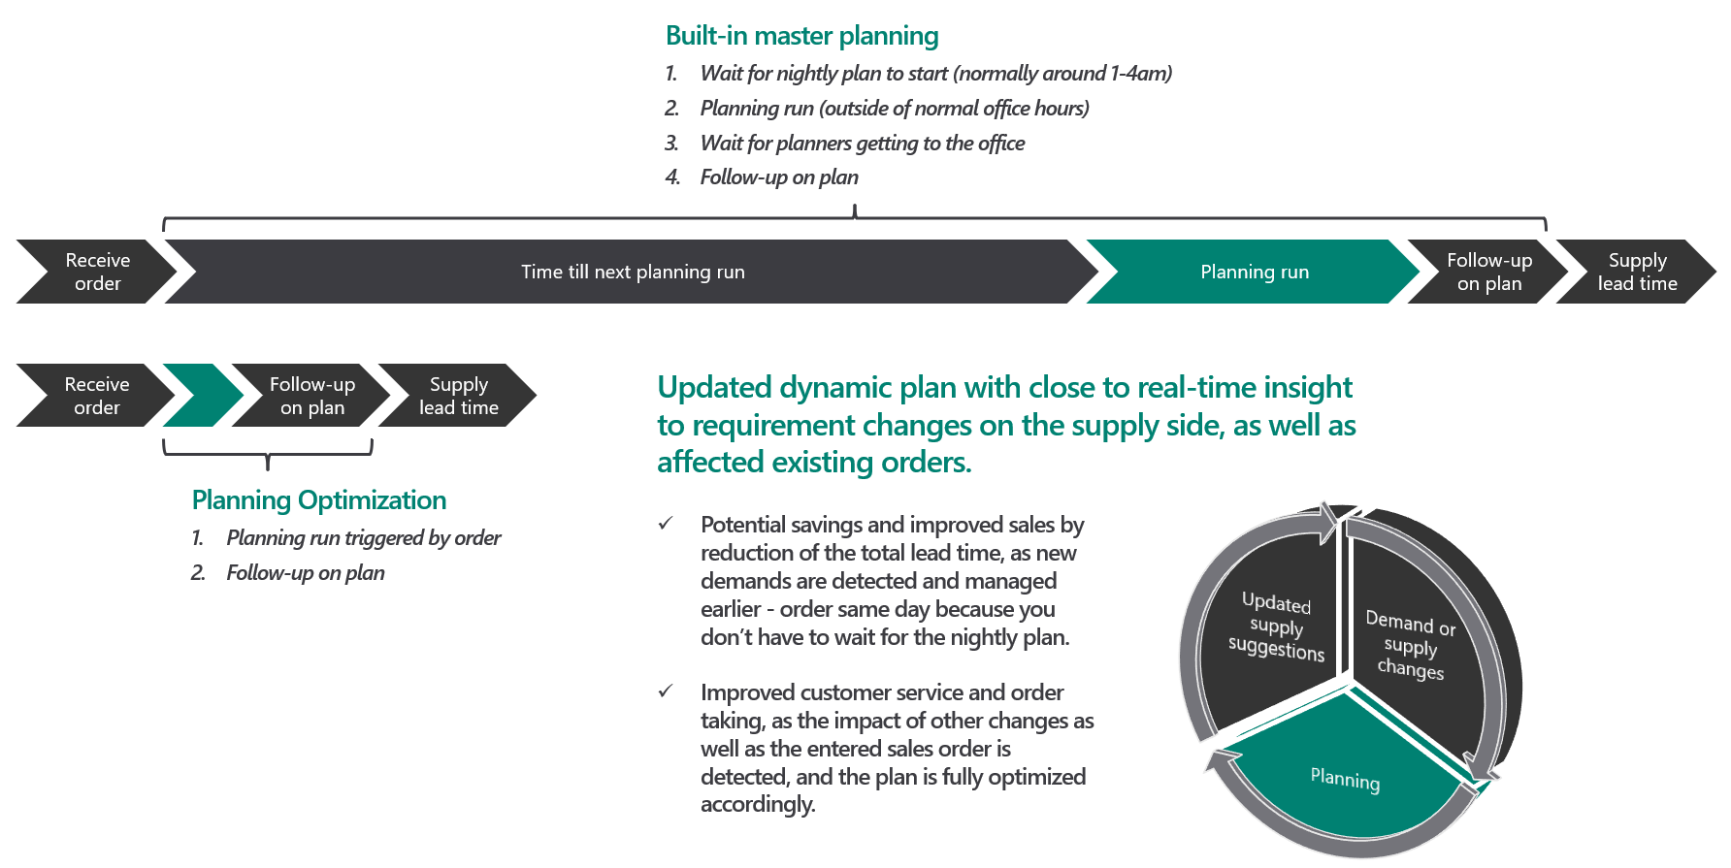
Planning Optimization

Slide 20
Planning Optimization
To configure whether the Planning Optimization Add-in should be used for master planning, go to Master planning > Setup > Planning Optimization parameters.
Connection status | Description | Can Planning Optimization be used?
Connected | A connection has been established between the Planning Optimization service and Supply Chain Management. | Yes
Enabling connection | A request to turn on the connection to the Planning Optimization service is currently in progress. | No
Disconnected | There is no connection to the Planning Optimization service. The connection can be turned on from LCS, as described earlier in this article. | No
Disabling connection | A request to turn off the connection to the Planning Optimization service is currently in progress. | No
Getting status | The system is waiting for status information from the Planning Optimization service. | No

Slide 21
Connection status | Description | Can Planning Optimization be used?
Connected | A connection has been established between the Planning Optimization service and Supply Chain Management. | Yes
Enabling connection | A request to turn on the connection to the Planning Optimization service is currently in progress. | No
Disconnected | There is no connection to the Planning Optimization service. The connection can be turned on from LCS, as described earlier in this article. | No
Disabling connection | A request to turn off the connection to the Planning Optimization service is currently in progress. | No
Getting status | The system is waiting for status information from the Planning Optimization service. | No

Slide 22
Changes | Feature management details | Release dates
General performance, quality, and stability improvements. | No feature management is required. | August 29 - September 3, 2022
General performance, quality, and stability improvements. Planning Optimization centralized calendar maintenance Planning Optimization suggestions to optimize existing supply Planning Optimization support for subcontracting | No feature management is required. | March 7-11, 2022
Added planning priority support for production orders. | Available with version 10.0.25 as part of the feature named Priority driven MRP support for Planning Optimization. | November 12-18, 2021
General performance, quality, and stability improvements. | No feature management is required. | November 12-18, 2021
Added support for process time calculation formulas, production route with overlap, and production operation number on requirement transactions. Enhanced error messages for production scheduling related to timeout, capacity could not be found, and cyclic route. Improved consistency when calculating receipt dates and issue dates on both planned orders and firmed orders. General performance, quality, and stability improvements. | Feature name: Infinite capacity scheduling for Planning Optimization | October 22-27, 2021
Added support for considering scrap percentage in processing time calculation. Added support for operation number and materials usage during scheduling. | Feature name: Infinite capacity scheduling for Planning Optimization | October 5-7, 2021
Added support for production route job types: Queue before, Queue after, and Transport time. General performance, quality, and stability improvements. | Feature name: Infinite capacity scheduling for Planning Optimization | September 25-30, 2021
Added support for master plans with Scheduling method set to Operations scheduling. On the Route groups page, respect settings for the Activation, Working time, and Capacity check boxes for rows with a Route/job type of Setup or Process. General performance, quality, and stability improvements. | Operations scheduling is available in feature management as of version 10.0.20. Feature name: Infinite capacity scheduling for Planning Optimization | September 9–17, 2021
General performance, quality, and stability improvements. | No feature management is required. | August 25–30, 2021
Added Lead time field to planned orders. General performance, quality, and stability improvements. | No feature management is required. | August 12–17, 2021
Added resource type requirements for infinite capacity scheduling. Improved resource efficiency and calendar efficiency for infinite capacity scheduling. For more information, see Scheduling with infinite capacity. | Available in feature management as of version 10.0.20. Feature name: Infinite capacity scheduling for Planning Optimization | July 6–12, 2021
General quality improvements. | No feature management is required. | July 6–12, 2021

Slide 23
Changes | Feature management details | Release dates
General performance, quality, and stability improvements. | No feature management is required. | August 29 - September 3, 2022
General performance, quality, and stability improvements. Planning Optimization centralized calendar maintenance Planning Optimization suggestions to optimize existing supply Planning Optimization support for subcontracting | No feature management is required. | March 7-11, 2022
Added planning priority support for production orders. | Available with version 10.0.25 as part of the feature named Priority driven MRP support for Planning Optimization. | November 12-18, 2021
General performance, quality, and stability improvements. | No feature management is required. | November 12-18, 2021
Added support for process time calculation formulas, production route with overlap, and production operation number on requirement transactions. Enhanced error messages for production scheduling related to timeout, capacity could not be found, and cyclic route. Improved consistency when calculating receipt dates and issue dates on both planned orders and firmed orders. General performance, quality, and stability improvements. | Feature name: Infinite capacity scheduling for Planning Optimization | October 22-27, 2021
Added support for considering scrap percentage in processing time calculation. Added support for operation number and materials usage during scheduling. | Feature name: Infinite capacity scheduling for Planning Optimization | October 5-7, 2021
Added support for production route job types: Queue before, Queue after, and Transport time. General performance, quality, and stability improvements. | Feature name: Infinite capacity scheduling for Planning Optimization | September 25-30, 2021
Added support for master plans with Scheduling method set to Operations scheduling. On the Route groups page, respect settings for the Activation, Working time, and Capacity check boxes for rows with a Route/job type of Setup or Process. General performance, quality, and stability improvements. | Operations scheduling is available in feature management as of version 10.0.20. Feature name: Infinite capacity scheduling for Planning Optimization | September 9–17, 2021
General performance, quality, and stability improvements. | No feature management is required. | August 25–30, 2021
Added Lead time field to planned orders. General performance, quality, and stability improvements. | No feature management is required. | August 12–17, 2021
Added resource type requirements for infinite capacity scheduling. Improved resource efficiency and calendar efficiency for infinite capacity scheduling. For more information, see Scheduling with infinite capacity. | Available in feature management as of version 10.0.20. Feature name: Infinite capacity scheduling for Planning Optimization | July 6–12, 2021
General quality improvements. | No feature management is required. | July 6–12, 2021

Slide 24
Tax calculation Service
Out-of-the-box integration with Dynamics 365 Finance, Dynamics 365 Supply Chain Management, and Dynamics 365 Project Operations.
Configuration of tax service through the Regulatory Configuration Service (RCS), which is an enhanced version of the Electronic Reporting designer available as a standalone service.
Configurable tax matrix to automatically determine tax codes and rates.
Configurable tax matrix to automatically determine VAT ID.
Configurable tax calculation designer to define formulas and conditions.
Shared tax determination and calculation solution across legal entities.
Notes:
Out-of-the-box integration with Dynamics 365 Finance, Dynamics 365 Supply Chain Management, and Dynamics 365 Project Operations.
Configuration of tax service through the Regulatory Configuration Service (RCS), which is an enhanced version of the Electronic Reporting designer available as a standalone service.
Configurable tax matrix to automatically determine tax codes and rates.
Configurable tax matrix to automatically determine VAT ID.
Configurable tax calculation designer to define formulas and conditions.
Shared tax determination and calculation solution across legal entities.

Slide 25
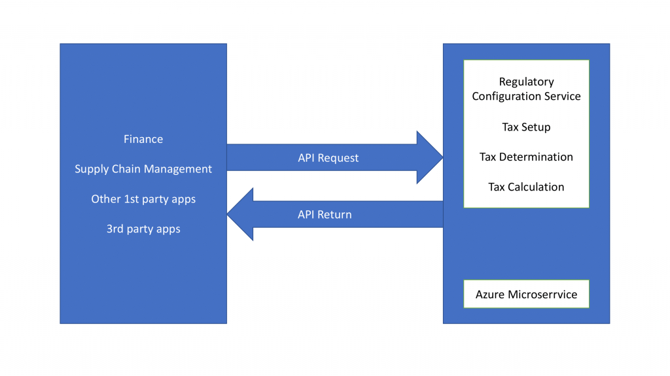
Tax calculation Service
Notes:
Out-of-the-box integration with Dynamics 365 Finance, Dynamics 365 Supply Chain Management, and Dynamics 365 Project Operations.
Configuration of tax service through the Regulatory Configuration Service (RCS), which is an enhanced version of the Electronic Reporting designer available as a standalone service.
Configurable tax matrix to automatically determine tax codes and rates.
Configurable tax matrix to automatically determine VAT ID.
Configurable tax calculation designer to define formulas and conditions.
Shared tax determination and calculation solution across legal entities.

Slide 26
Tax Calculation Service
Too much to talk about for specifics because its about taxes
https://learn.microsoft.com/en-us/dynamics365/finance/localizations/global-tax-calcuation-service-overview?toc=%2Fdynamics365%2Ffinance%2Ftoc.json

Slide 27
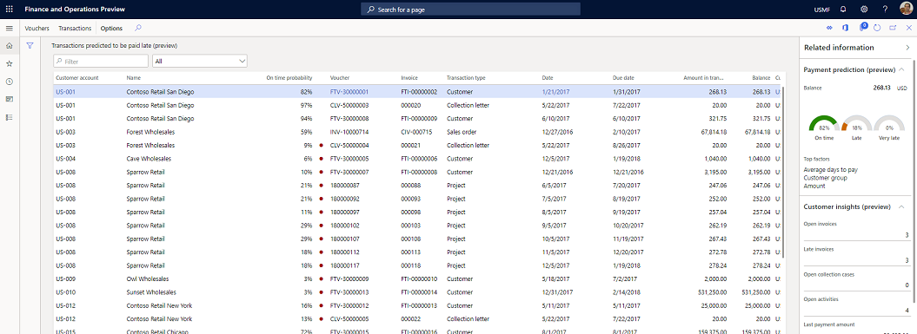
Finance Insights
Enables customer payment predictions
Notes:
https://www.powerazure365.com/blog-1/dynamics-365-finance-insights

Slide 28
Notes:
https://www.powerazure365.com/blog-1/dynamics-365-finance-insights

Slide 29
Finance Insights
Enables cash flow forecasting
Give the “model” more data to make it more accurate
monitor and manage their cash balances effectively
What-if Analysis
Review forecasts in multiple currencies, legal entities with filters
Notes:
https://www.powerazure365.com/blog-1/dynamics-365-finance-insights

Slide 30
Finance Insights
Features to enable:
payment predictions
Cash flow forecasts
Budget proposal
Notes:
https://www.powerazure365.com/blog-1/dynamics-365-finance-insights

Slide 31
Finance Insights
https://learn.microsoft.com/en-us/dynamics365/finance/finance-insights/enable-cust-paymnt-prediction
https://learn.microsoft.com/en-us/dynamics365/finance/finance-insights/enable-cash-flow-forecasting
https://learn.microsoft.com/en-us/dynamics365/finance/finance-insights/external-data-in-cash-flow

Slide 32
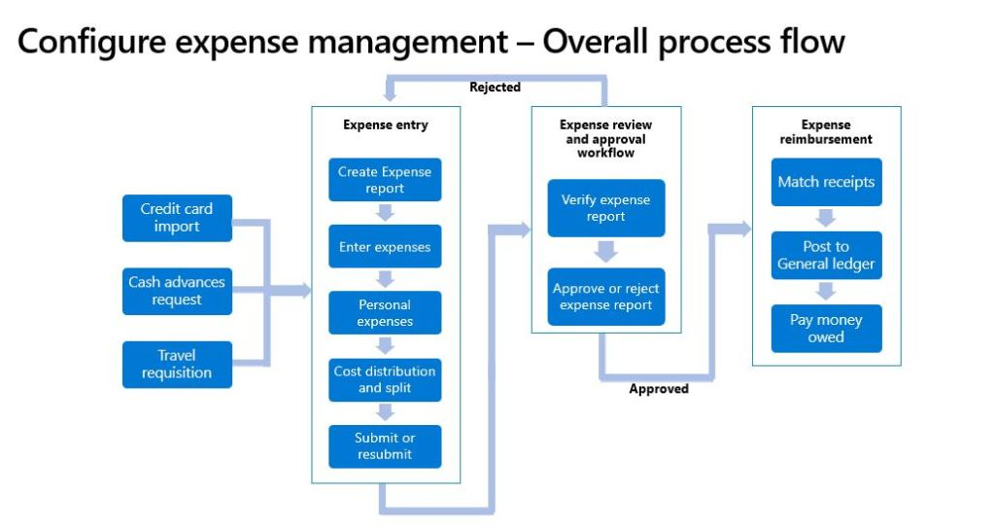
Expense Management
“Expense Reports Reimagined”
Notes:
https://learn.microsoft.com/en-us/dynamics365/project-operations/expense/match-receipt-expense-ocr
https://www.d365fandom.com/2022/08/ocr-in-expense-management.html

Slide 33
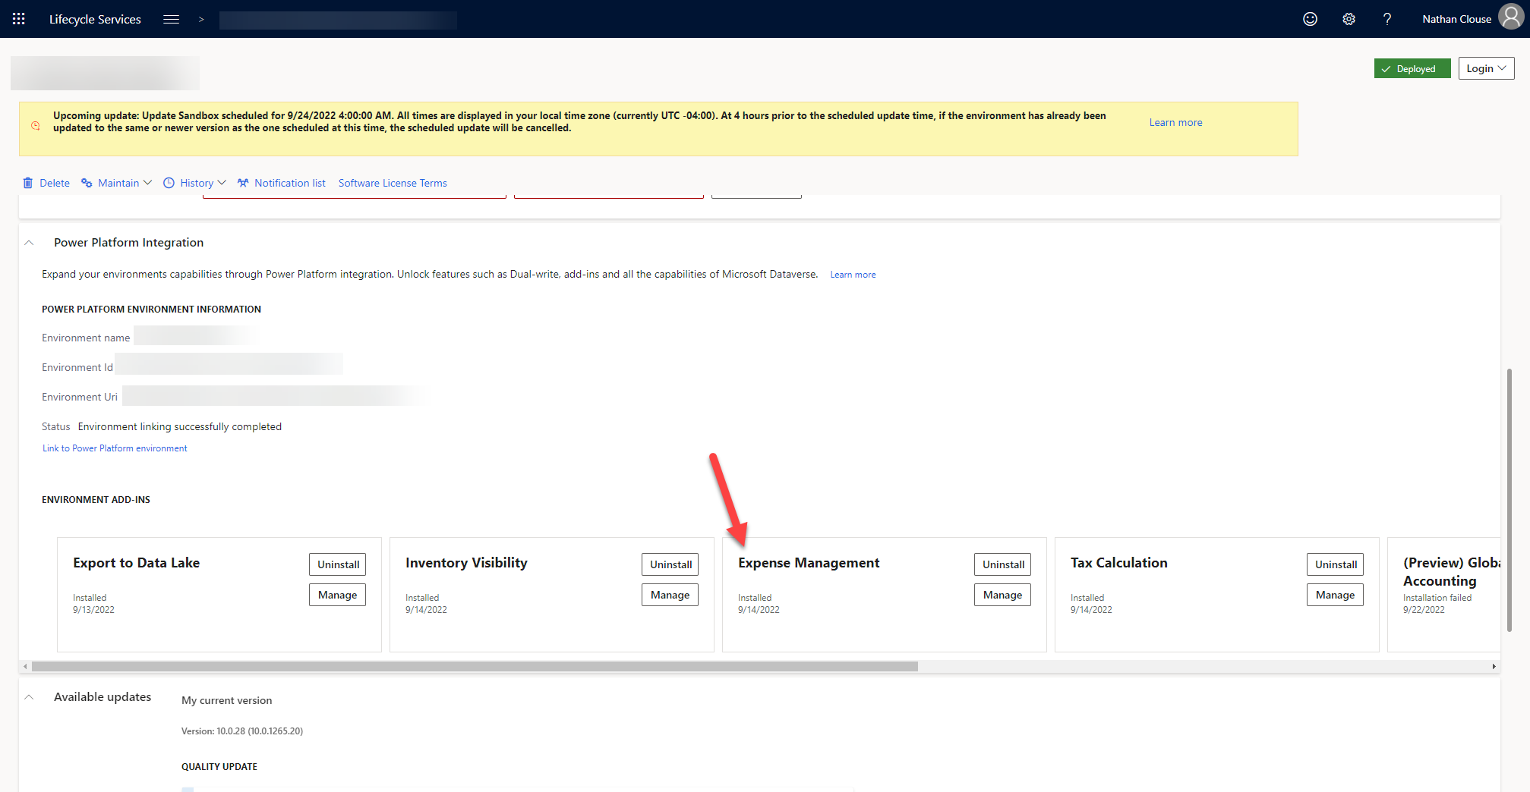
Expense Management
Notes:
https://learn.microsoft.com/en-us/dynamics365/project-operations/expense/match-receipt-expense-ocr
https://www.d365fandom.com/2022/08/ocr-in-expense-management.html

Slide 34
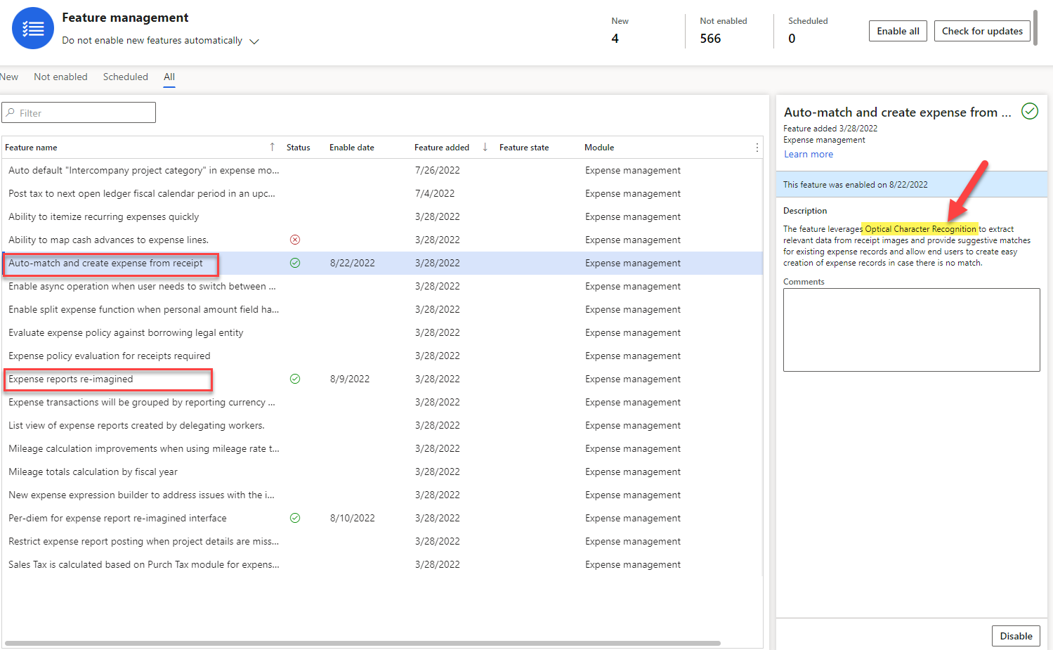
Expense Management
Notes:
https://learn.microsoft.com/en-us/dynamics365/project-operations/expense/match-receipt-expense-ocr
https://www.d365fandom.com/2022/08/ocr-in-expense-management.html

Slide 35
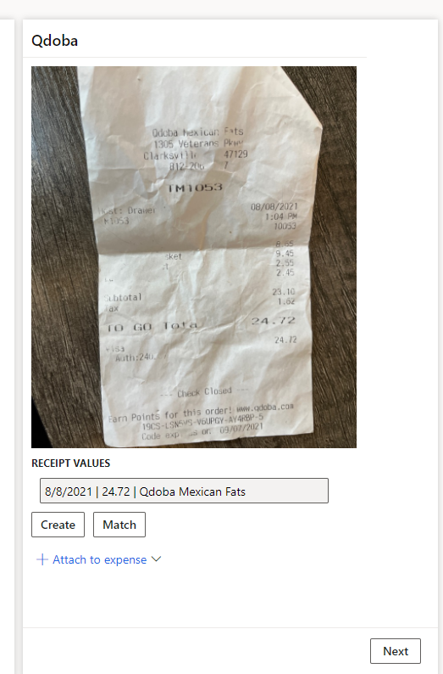
Notes:
https://learn.microsoft.com/en-us/dynamics365/project-operations/expense/match-receipt-expense-ocr
https://www.d365fandom.com/2022/08/ocr-in-expense-management.html

Slide 36
Notes:
https://learn.microsoft.com/en-us/dynamics365/project-operations/expense/match-receipt-expense-ocr
https://www.d365fandom.com/2022/08/ocr-in-expense-management.html

Slide 37
Expense Management
Includes feature “Expense Reports Reimagined”
https://learn.microsoft.com/en-us/dynamics365/project-operations/expense/expense-reports-reimagined
Lots of related functionality, options, configs
Receipt OCR is only available in USA, UK, CAN, and AUS. EU support is limited to English receipts at the moment.

Slide 38
Electronic Invoicing
Fast and easy adoption of country/region-specific requirements
Standardized implementations of an Electronic invoicing solution
Enhanced traceability of document history
Easily adjustable configurations that don't require code changes
Simplified configuration packaging
Built-in export, import, and integration, and easy extensibility in the processing of e-invoice documents
Easy reuse of the same export, import, and integration configurations across companies
Tech Talk: https://www.youtube.com/watch?v=Eo1VtUiL14E
Notes:
https://www.powerazure365.com/blog-1/e-invoicing-services-for-dynamics-365-finance-and-operations

Slide 39
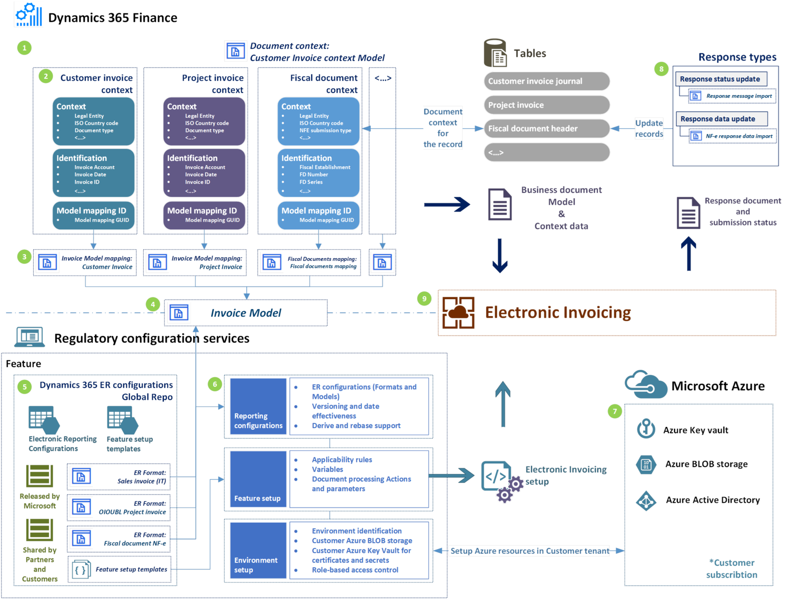
Electronic Invoicing
Notes:
https://www.powerazure365.com/blog-1/e-invoicing-services-for-dynamics-365-finance-and-operations

Slide 40
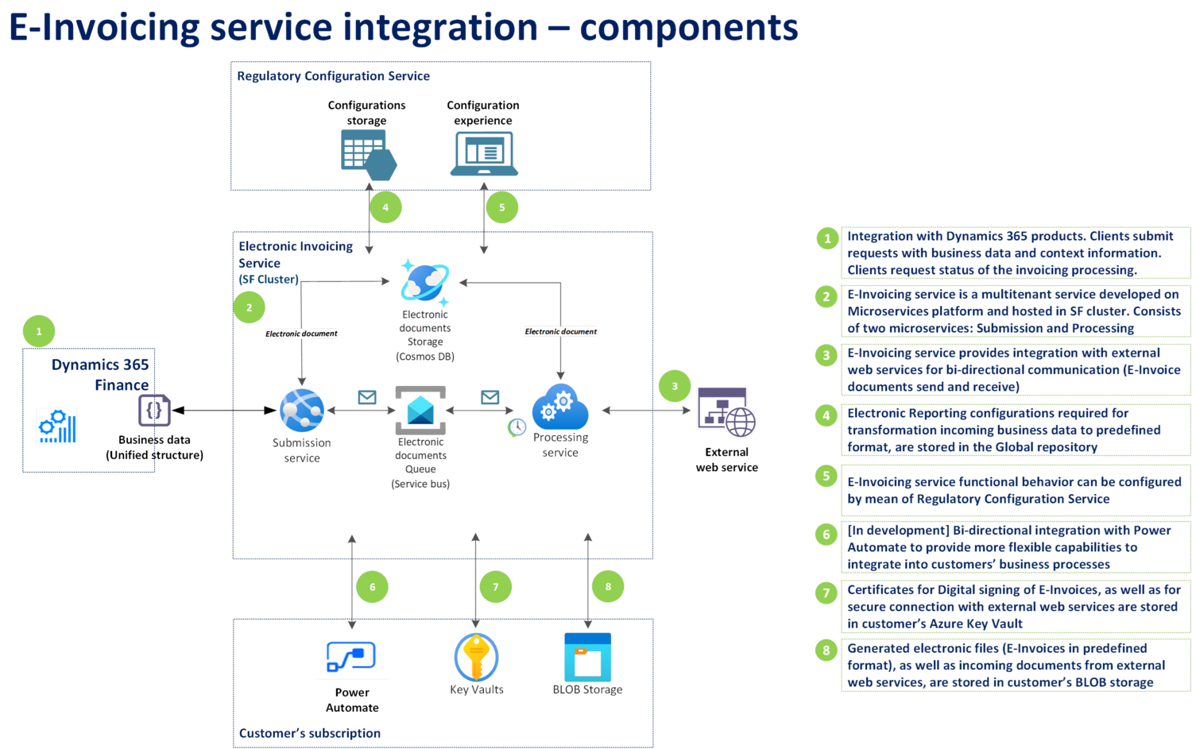
Electronic Invoicing
Notes:
https://www.powerazure365.com/blog-1/e-invoicing-services-for-dynamics-365-finance-and-operations

Slide 41
Inventory Visibility
Scalable microservice to track near real time on hand inventory
Global view of inventory on hand
View inventory on hand across site, warehouses, and other sets of dimensions
Provides a set of RESTful APIs to view on hand, adjust on hands and reserve on hand
Power App to configure new data sources for external systems, dimensions, product index hierarchies, measures and calculated measures
Built on Dataverse and provides extensibility
Newest version(s) have additional configurations available in F&O to suit your needs
Tech Talk: https://www.youtube.com/watch?v=rrPbpGAz3Zk
Notes:
https://www.powerazure365.com/blog-1/dynamics-365-inventory-visibility
https://learn.microsoft.com/en-us/dynamics365/supply-chain/inventory/inventory-visibility-api
https://www.youtube.com/watch?v=rrPbpGAz3Zk

Slide 42
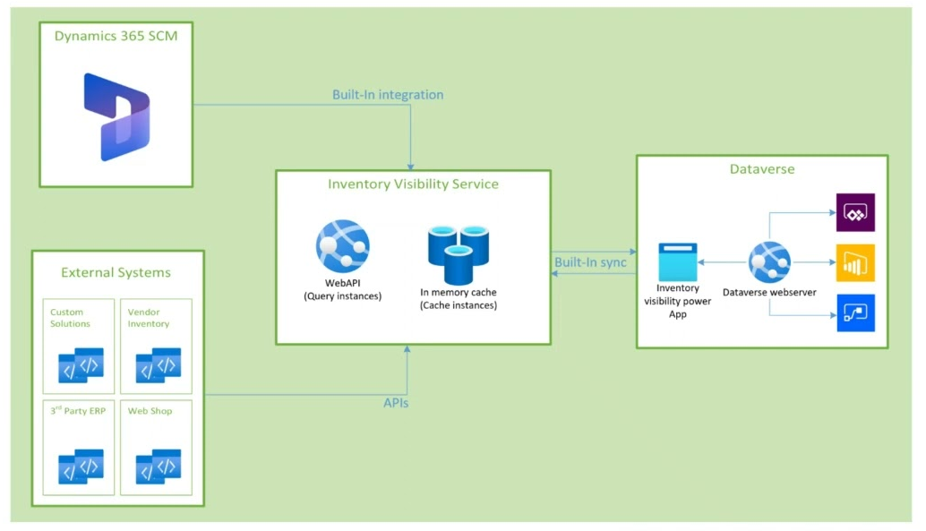
Inventory Visibility
Notes:
https://www.powerazure365.com/blog-1/dynamics-365-inventory-visibility

Slide 43
IoT Intelligence
Renamed within 30 days to Sensor Data intelligence (in 10.0.30)
Sensor Data Intelligence is IoT Intelligence version 2.0
Microsoft doesn’t recommend starting any new projects with IoT Intelligence
Sensor Data Intelligence offers new features, scenarios and functionality
Collect details form machines to update maintenance counters
Features onboarding wizard in LCS
Deploy components in your Azure Subscription so you have more flexibility and extensibility options
Configure, scale and extend business logic on Azure components in your subscription

Slide 44
IoT Intelligence Senor Data Intelligence
Asset downtime - Accurately track the efficiency of machine assets by using sensor data to track machine downtime.
Asset maintenance - Minimize maintenance cost and extend asset life by improving maintenance plans based on sensor readings of critical control points for machine assets.
Machine status - Ensure operation efficiency by using sensor readings to notify planners about machine outages and provide options for mitigating potential delays.
Product quality - Ensure the quality of product batches by comparing sensor readings for actual properties of each product batch, such as moisture, temperature, or custom-defined quality metrics. The system will notify users when deviations occur.
Production delays - Use sensor readings to compare actual cycle time to planned cycle time, and notify supervisors when production isn't on schedule. Supervisors can then intervene as required to ensure maximum operation efficiency.

Slide 45
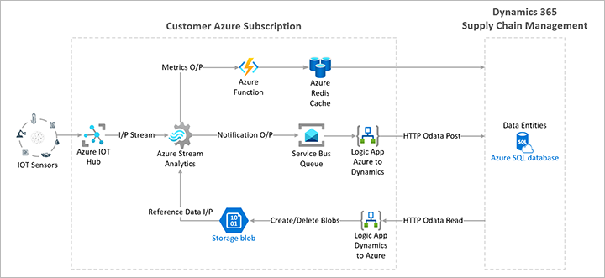
IoT Intelligence Senor Data Intelligence

Slide 46
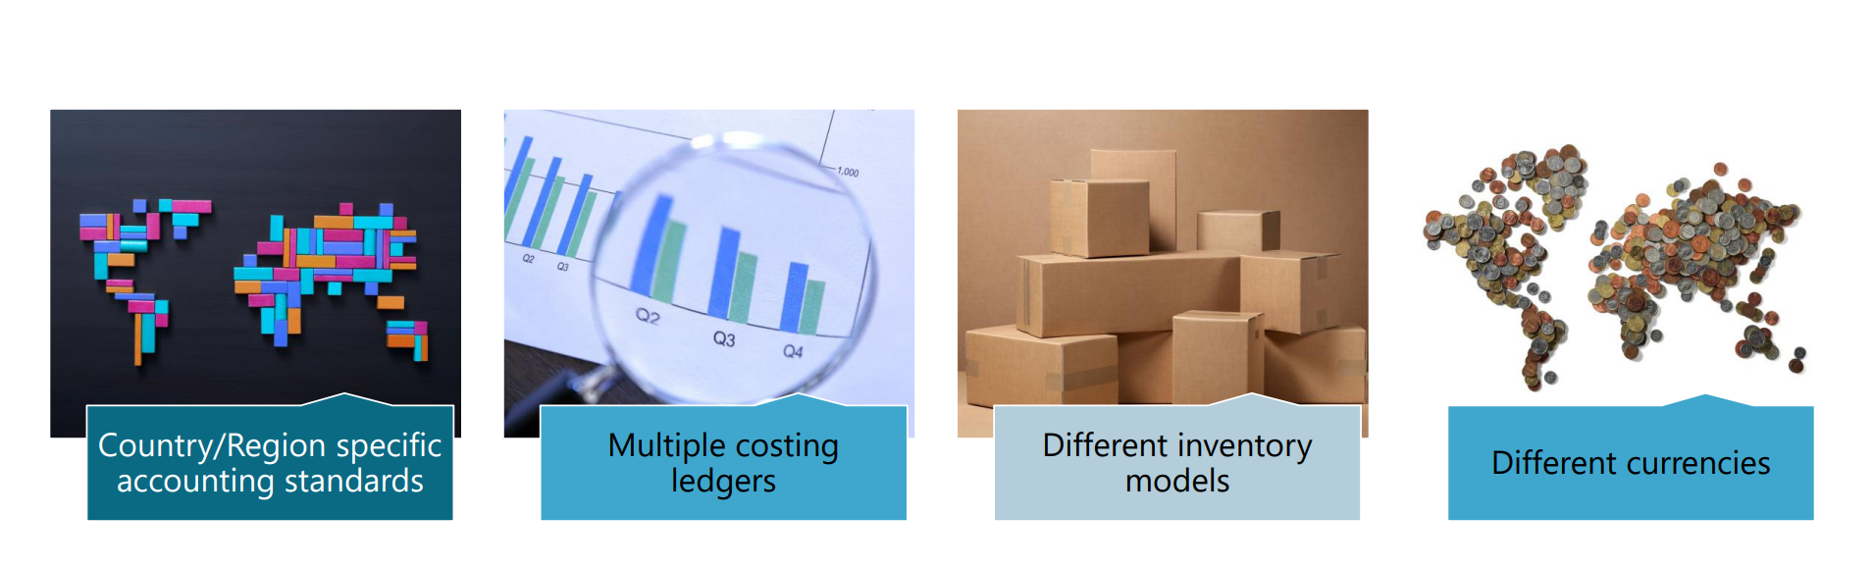
(Preview) Global inventory Accounting
Notes:
https://community.dynamics.com/cfs-filesystemfile/__key/communityserver-components-sitefiles/TechTalk+Presentation+Files/DTT052EXT-_2D00_-06_5F00_Global-Inventory-Accounting.pdf?_=637846962496609130
https://www.powercommunity.com/part-6-global-inventory-accounting-add-in-for-dynamics-365-supply-chain-management-march-29-2022/

Slide 47
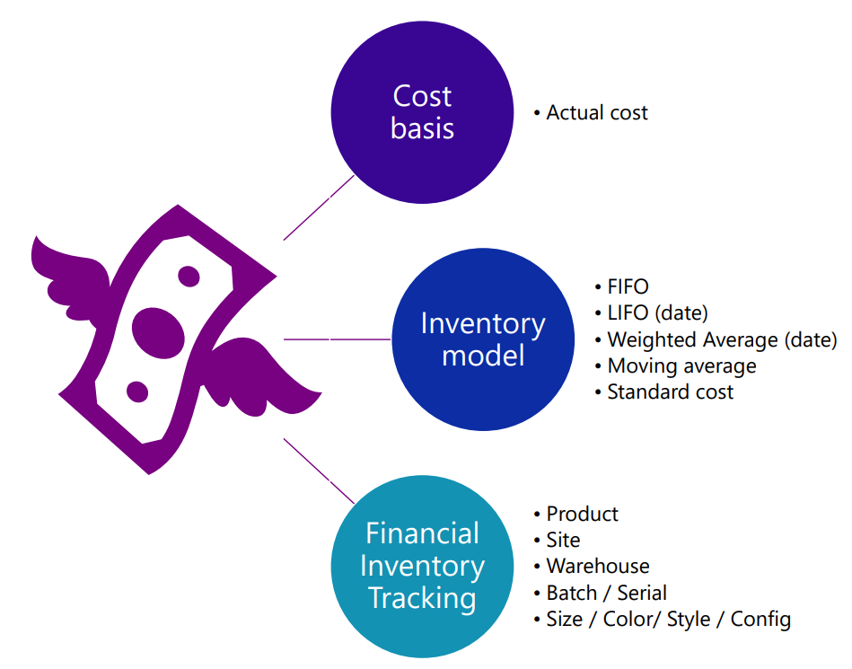
(Preview) Global inventory Accounting
Notes:
https://community.dynamics.com/cfs-filesystemfile/__key/communityserver-components-sitefiles/TechTalk+Presentation+Files/DTT052EXT-_2D00_-06_5F00_Global-Inventory-Accounting.pdf?_=637846962496609130

Slide 48
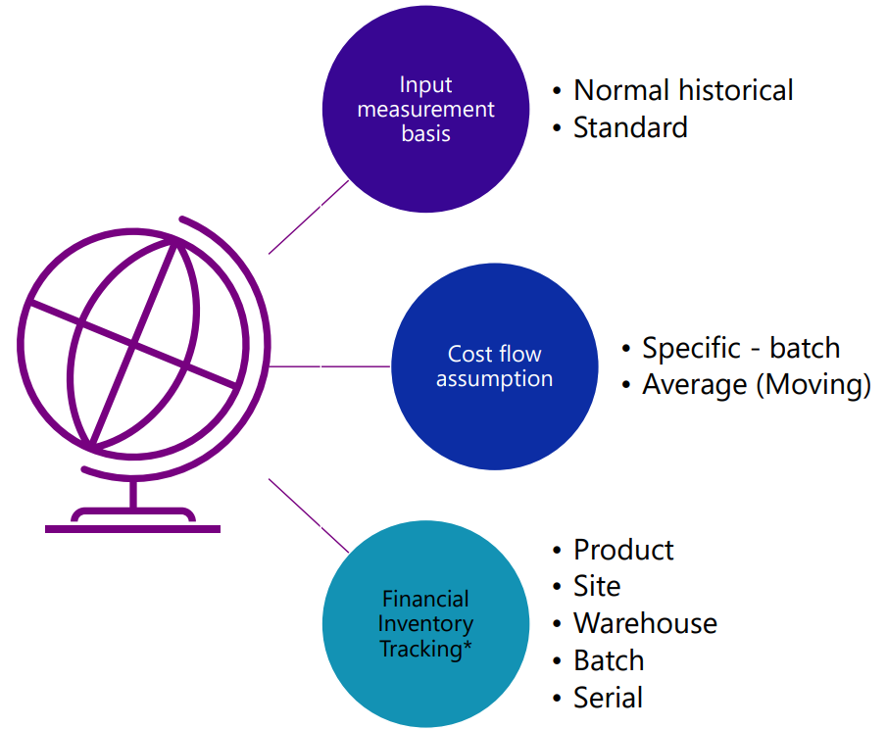
(Preview) Global inventory Accounting

Slide 49
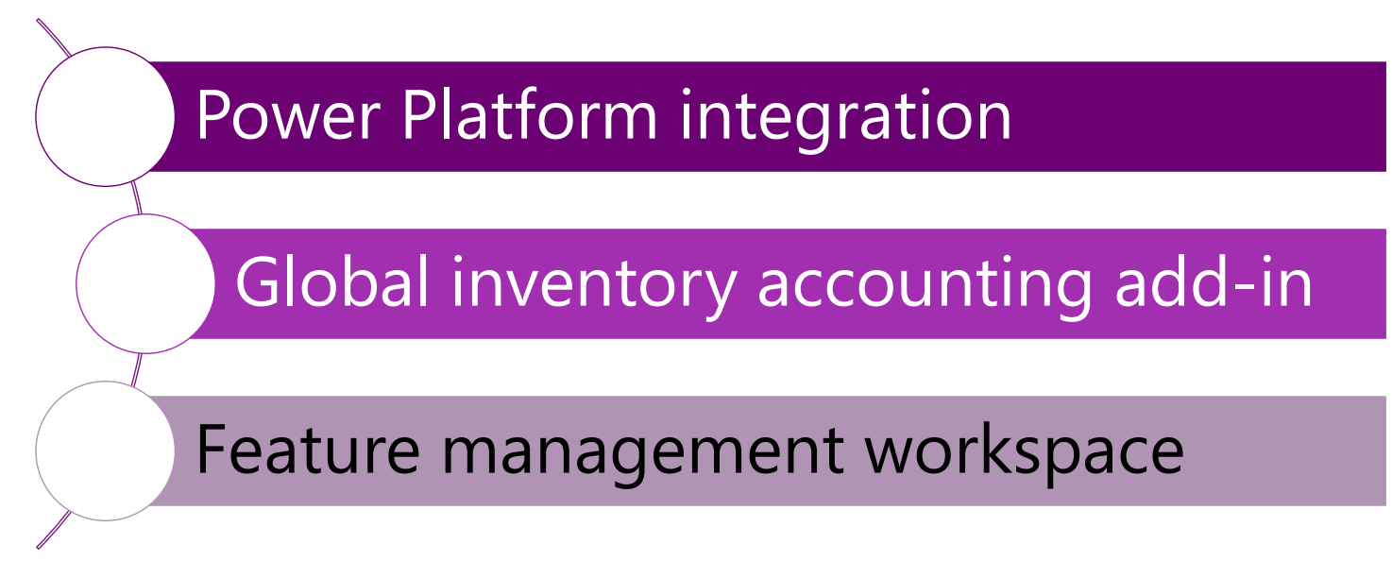
(Preview) Global inventory Accounting
Prerequisites

Slide 50
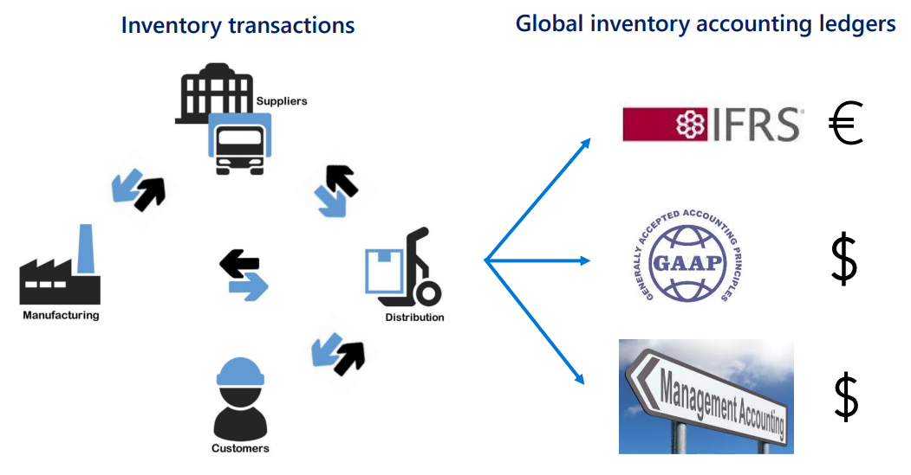
(Preview) Global inventory Accounting
Notes:
International Financial Reporting Standards

Slide 51
(Preview) Global inventory Accounting
https://community.dynamics.com/365/dynamics-365-fasttrack/b/techtalks/posts/part-6-global-inventory-accounting-add-in-for-dynamics-365-supply-chain-management-march-29-2022
Anne Krumpke and Rachel Profit are here
Anne Krumpke will be F&O Tech Medic booth from 2 to 3 today

Slide 52
Can I Write My Own Micro Services?
Sort of, yes. It depends.
OData and Custom Services are throttled now (or will be very soon) so keep that in mind
For read only workloads, yes. Can use Data lake for data needs without touching F&O
For CUD workloads, its complicated
Could use DMF with a scheduler
DMF has recurring integrations and data jobs to assist
OData and Custom Services could hit a “429” wall
Messaging with middleware and after the fact reconciliation will be the best option

Slide 53
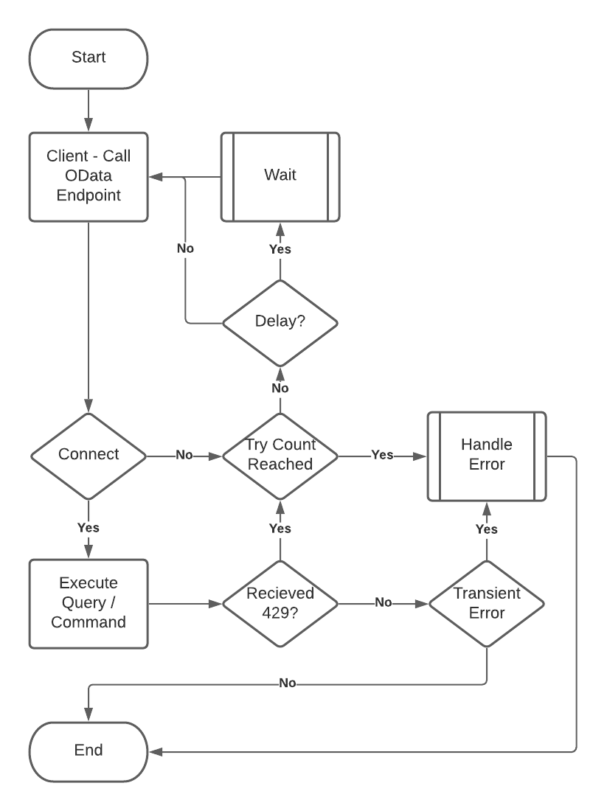

Slide 55
Give Away
Also, all of my PowerPoints will be available for download at https://github.com/NathanClouseAX/CommunityPresentations/tree/master/2022 by end of the week

Slide 56


